Slide 1
IoT Monitoring Dashboard Capstone Project — Milestone Progress Update
Program BAS Application Development
Course CSI-492 Senior Capstone Project
Student Quoc Bao Tran Date 5/3

Slide 2
Schedule Update Status: On track
Project Progress Update
Time Period | Dates |  | Focus |  | Status/Progress Update
Week 1–2 | 4/6 – 4/19 |  | Planning — project charter, requirements, architecture |  | Project charter approved; requirements documented; architecture defined (MQTT → API → SQL → SignalR → React).
Week 3–4 | 4/20 – 5/3 |  | Data — SQL Server schema, EF Core entities, migrations, seed/test data |  | SQL schema designed; EF Core entities & migrations applied; seed/test data loaded.
Week 5–6 | 5/4 – 5/17 |  | Backend — repositories, services, REST API, MQTT ingest, command dispatch, SignalR, alerts.
Week 7–8 | 5/18 – 5/31 |  | Frontend — React dashboard, auth, live charts, devices, commands, alerts UI
Week 9–10 | 6/1 – 6/14 |  | Integration & testing — Arduino ↔ Mosquitto ↔ API ↔ SQL ↔ SignalR ↔ UI (end-to-end)
Week 11 | 6/15 – 6/19 |  | Documentation & presentation — final docs, polish, demo prep → Final presentation 6/17

Slide 3
Milestone Summary
Status: Completed
Goal: Build the database layer to store devices, sensors, readings, alerts, commands, actuators, and users.
Completed work:
Designed SQL Server schema (IoTMonitoringDB on LocalDB)
Created EF Core entities (Device, Sensor, SensorReading, Alert, AlertRule, DeviceCommand, Actuator, User, etc.)
Configured ApplicationDbContext with DbSet tables, foreign keys, and delete rules
Applied EF Core migrations (InitialCreate and follow-on updates)
Prepared seed/test data and reset scripts (Documents/database/) for repeatable testing with Arduino/API
Progress (schedule table): SQL schema designed; EF entities & migrations applied; seed/test data and reset scripts ready.

Slide 4
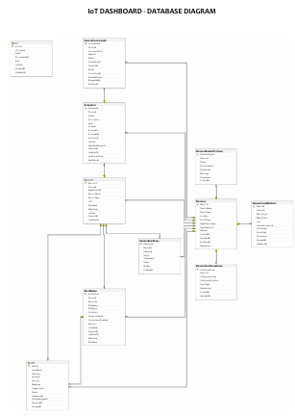
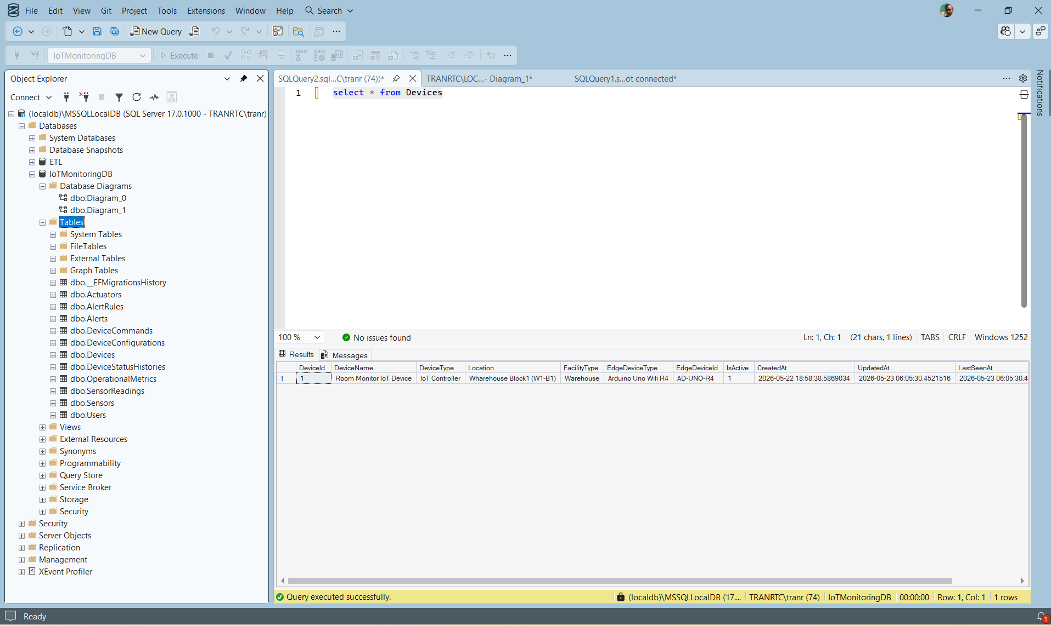
Evidence / Screenshot
Fig. 1 — ERD Design
Ctr + click link so see full
Fig. 2 — Implementation
Tables in In SQL

Slide 5
Problems & solutions
Problem | Solution
Entity relationships unclear (Device → Sensor → Reading) | Mapped FKs in ApplicationDbContext and verified with initial migration
Test data IDs did not match Arduino DEVICE_ID / SENSOR_ID | Aligned sketch constants to DB IDs
Migration errors after schema changes | Re-ran dotnet ef database update; used reset script for clean local testing

Slide 6
Barriers
No other critical blockers at this milestone.

Slide 7
Reflection & next steps
Learned: Data model must match MQTT topics and API DTOs early; good schema reduces backend/frontend rework.
Next (Week 5–6): Repositories, services, REST API, MQTT ingest, SignalR, and alerts.

